Slide 1
UNIT –II Introduction to Big data

Slide 3
CHARACTERISTICS OF DATA
Data has three key characteristics:
1. Composition
2. Condition
3. Context

Slide 4
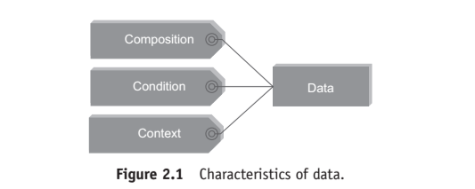

Slide 5
1. Composition
The composition of data deals with the structure of data,
that is, the sources of data, the granularity, the types, and the nature of data as to whether it is static or real-time streaming.

Slide 6
2. Condition:
The condition of data deals with the state of data, that is, “Can one use this data as is for analysis?” or “Does it require cleansing for further enhancement and enrichment?”

Slide 7
3. Context
The context of data deals with “Where has this data been generated?” “Why was this data generated?” “How sensitive is this data?” “What are the events associated with this data?” and so on.

Slide 8
2.2 EVOLUTION OF BIG DATA
1970s and before was the era of mainframes. The data was essentially primitive and structured.
Relational databases evolved in 1980s and 1990s. The era was of data intensive applications.

Slide 9
The World Wide Web (WWW) and the Internet of Things (IoT) have led to an onslaught of structured, unstructured, and multimedia data.

Slide 10
2.3 DEFINITION OF BIG DATA
Well, we will give you a few responses that we have heard over time:
1. Anything beyond the human and technical infrastructure needed to support storage, processing, and analysis.

Slide 11
2. Today’s BIG may be tomorrow’s NORMAL.
3. Terabytes or petabytes or zettabytes of data.
4. I think it is about 3 Vs.

Slide 12
Big data definition
Big data is high-volume, high-velocity, and high-variety information assets that demand cost effective, innovative forms of information processing for enhanced insight and decision making.

Slide 13
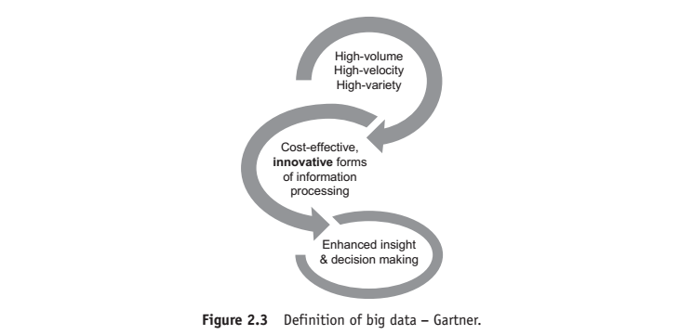

Slide 14
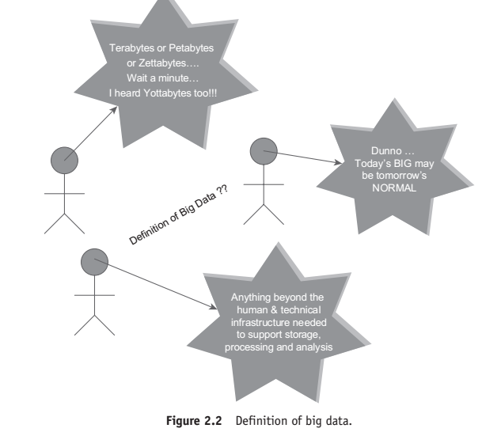

Slide 15
Part I of the definition
“big data is high-volume, high-velocity, and high-variety information assets” talks about voluminous data (humongous data) that may have great variety (a good mix of structured, semi-structured, and unstructured data)
and will require a good speed/pace for storage, preparation, processing, and analysis.

Slide 16
Part II of the definition
“cost effective, innovative forms of information processing” talks about embracing new techniques and technologies to capture (ingest), store, process, persist, integrate, and visualize the high-volume, high-velocity, and high-variety data.

Slide 17
Part III of the definition
“enhanced insight and decision making” talks about deriving deeper, richer, and meaningful insights and then using these insights to make faster and better decisions to gain business value and thus a competitive edge.

Slide 18
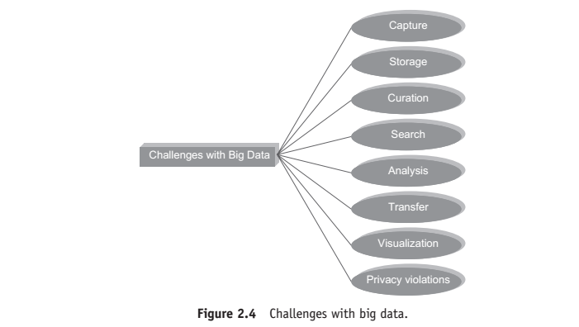

Slide 19
4 CHALLENGES WITH BIG DATA
1. Data today is growing at an exponential rate.
Most of the data that we have today has been generated in the last 2–3 years.
This high tide of data will continue to rise incessantly.

Slide 20
The key questions here are: “Will all this data be useful for analysis?”,
“Do we work with all this data or a subset of it?”,
“How will we separate the knowledge from the noise?”, etc.

Slide 21
2. Cloud computing and virtualization are here to stay.
Cloud computing is the answer to managing infrastructure for big data as far as cost-efficiency, elasticity, and easy upgrading/downgrading is concerned.

Slide 22
This further complicates the decision to host big data solutions outside the enterprise.

Slide 23
3. The other challenge is to decide on the period of retention of big data.
Just how long should one retain this data?

Slide 24
A tricky question indeed as some data is useful for making long-term decisions, whereas in few cases, the data may quickly become irrelevant and obsolete just a few hours after having being generated.

Slide 25
4. There is a dearth of skilled professionals who possess a high level of proficiency in data sciences that is vital in implementing big data solutions.

Slide 26
5. Then, of course, there are other challenges with respect to capture, storage, preparation, search, analysis, transfer, security, and visualization of big data.

Slide 27
Big data refers to datasets whose size is typically beyond the storage capacity of traditional database software tools.

Slide 28
There is no explicit definition of how big the dataset should be for it to be considered “big data.”
Here we are to deal with data that is just too big, moves way to fast, and does not fit the structures of typical database systems.

Slide 29
The data changes are highly dynamic and therefore there is a need to ingest this as quickly as possible.

Slide 30
6. Data visualization is becoming popular as a separate discipline.
We are short by quite a number, as far as business visualization experts are concerned.

Slide 31
WHAT IS BIG DATA?
Big data is data that is big in volume, velocity, and variety.

Slide 32
Volume
We have seen it grow from bits to bytes to petabytes and exabytes.
Bits → Bytes → Kilobytes → Megabytes → Gigabytes → Terabytes → Petabytes → Exabytes → Zettabytes → Yottabytes

Slide 33
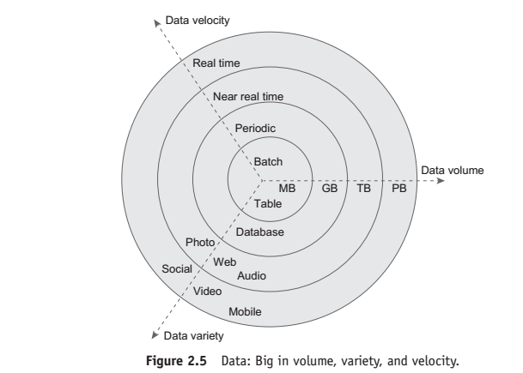

Slide 34
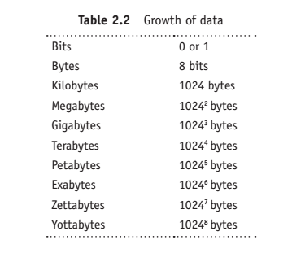

Slide 35
Where Does This Data get Generated?
There are a multitude of sources for big data. An XLS, a DOC, a PDF, etc. is unstructured data;

Slide 36
a video on YouTube, a chat conversation on Internet Messenger, a customer feedback form on an online retail website is unstructured data;
a CCTV coverage, a weather forecast report is unstructured data too

Slide 37
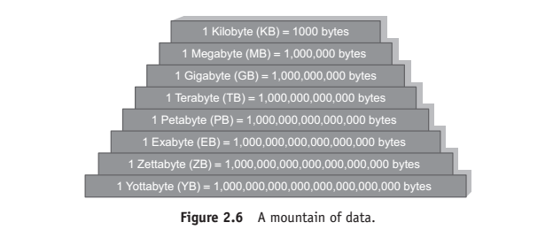

Slide 38
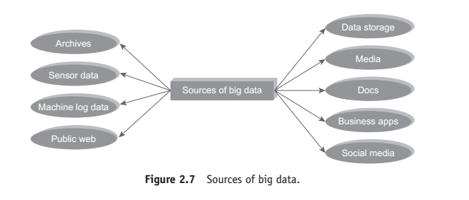

Slide 39
the sources of big data.
Typical internal data sources:
Data present within an organization’s firewall. It is as follows:
• Data storage:
File systems, SQL (RDBMSs – Oracle, MS SQL Server, DB2, MySQL, PostgreSQL, etc.), NoSQL (MongoDB, Cassandra, etc.), and so on.

Slide 40
• Archives:
Archives of scanned documents, paper archives, customer correspondence records, patients’ health records, students’ admission records, students’ assessment records, and so on.

Slide 41
2. External data sources:
Data residing outside an organization’s firewall. It is as follows:
• Public Web: Wikipedia, weather, regulatory, compliance, census, etc.

Slide 42
3. Both (internal + external data sources)
• Sensor data: Car sensors, smart electric meters, office buildings, air conditioning units, refrigerators, and so on.
• Machine log data: Event logs, application logs, Business process logs, audit logs, clickstream data, etc. • Social media: Twitter, blogs, Facebook, LinkedIn, YouTube, Instagram, etc.

Slide 43
• Business apps: ERP, CRM, HR, Google Docs, and so on.
• Media: Audio, Video, Image, Podcast, etc.
• Docs: Comma separated value (CSV), Word Documents, PDF, XLS, PPT, and so on.

Slide 44
2.5.2 Velocity
We have moved from the days of batch processing (remember our payroll applications) to real-time processing.
Batch → Periodic → Near real time → Real-time processing

Slide 45
Variety
Variety deals with a wide range of data types and sources of data.
We will study this under three categories:
Structured data, semi-structured data and unstructured data.

Slide 46
OTHER CHARACTERISTICS OF DATA WHICH ARE NOT DEFINITIONAL TRAITS OF BIG DATA
There are yet other characteristics of data which are not necessarily the definitional traits of big data.
Few of these are listed as follows:
1. Veracity and validity:
2. Volatility:
3. Variability:

Slide 47
1. Veracity and validity:
Veracity refers to biases, noise, and abnormality in data.
The key question here is: “Is all the data that is being stored, mined, and analyzed meaningful and pertinent to the problem under consideration?”

Slide 48
Validity refers to the accuracy and correctness of the data.
Any data that is picked up for analysis needs to be accurate. It is not just true about big data alone.

Slide 49
2. Volatility:
Volatility of data deals with, how long is the data valid?
And how long should it be stored? There is some data that is required for long-term decisions and remains valid for longer periods of time.
However, there are also pieces of data that quickly become obsolete minutes after their generation.

Slide 50
3. Variability:
Data flows can be highly inconsistent with periodic peaks.

Slide 51
WHY BIG DATA?
The more data we have for analysis, the greater will be the analytical accuracy and also the greater would be the confidence in our decisions based on these analytical findings.

Slide 52
More data → More accurate analysis → Greater confidence in decision making → Greater operational efficiencies, cost reduction, time reduction, new product development, and optimized offerings, etc.

Slide 53
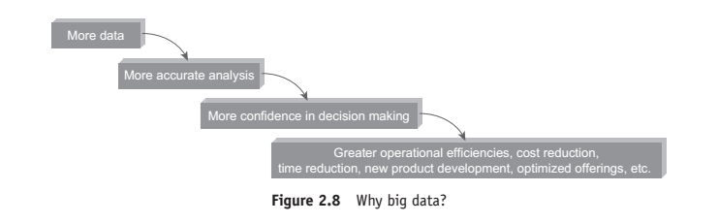

Slide 54
2.9 TRADITIONAL BUSINESS INTELLIGENCE (BI) VERSUS BIG DATA
1. In traditional BI environment, all the enterprise’s data is housed in a central server whereas in a big data environment data resides in a distributed file system.

Slide 55
The distributed file system scales by scaling in or out horizontally as compared to typical database server that scales vertically.

Slide 56
2. In traditional BI, data is generally analyzed in an offline mode whereas in big data, it is analyzed in both real time as well as in offline mode.

Slide 57
3. Traditional BI is about structured data and it is here that data is taken to processing functions (move data to code)
whereas big data is about variety: Structured, semi-structured, and unstructured data and here the processing functions are taken to the data (move code to data).

Slide 58
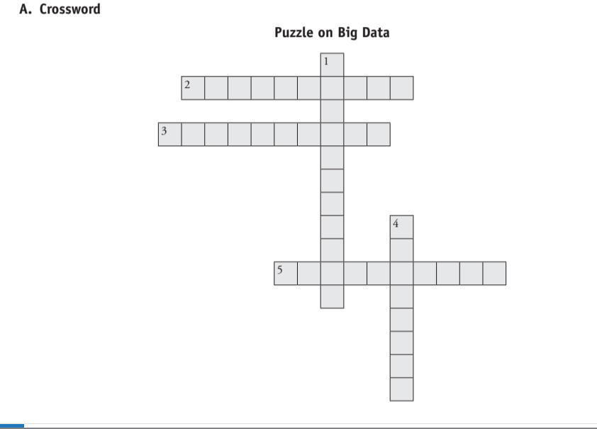
Puzzle

Slide 59
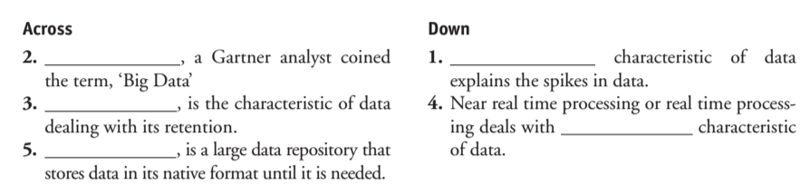

Slide 60
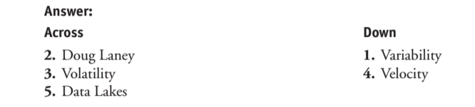

Slide 61
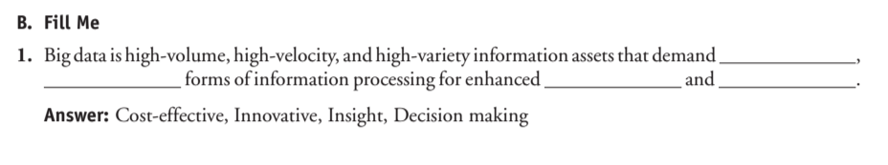

Slide 62
Answer: Cost-effective, Innovative, Insight, Decision making

Slide 63
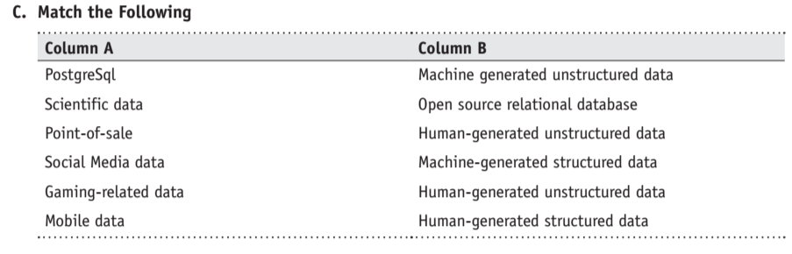

Slide 64
